Slide 1


Object Tracking
Christopher Caldarella
Data Scientist
2021-06-14
Notes:
Hello, My name is Christopher Caldarella, Data Scientist
And Today we will be looking at Object Tracking with Machine Learning

Slide 2
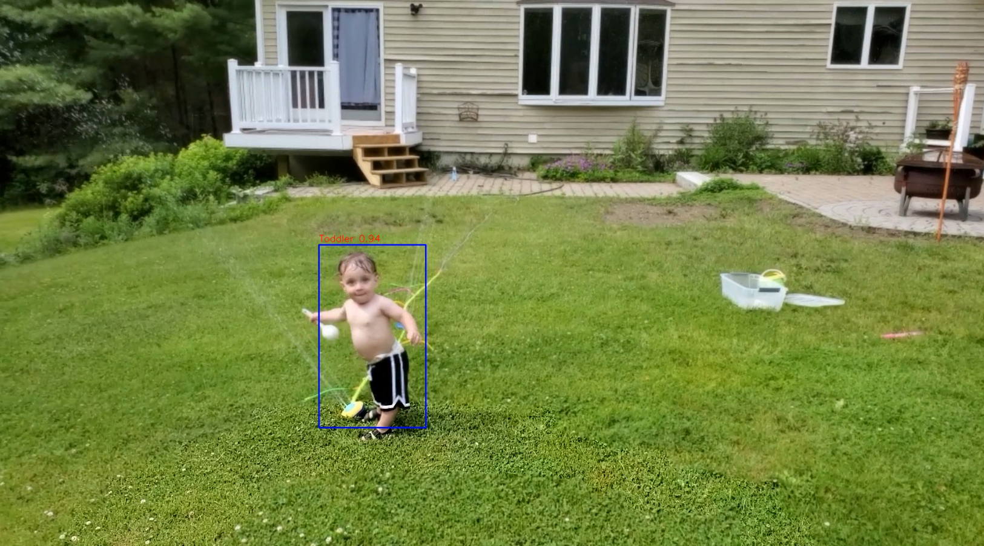
YES!
Is it possible to track a person and their movement with a moving camera?
Notes:
Is it possible to track a person and their movement with a moving camera?
The answer is yes!
But I was hoping to try this with my son.
And I did, yesterday afternoon, and it worked ok!
However, this setup does require good placement, and I have not quite found that yet in my house.
A little background here – I was inspired by this idea while being on video calls with the grandparents.
My little guy likes to run around and I end up following him with my phone instead of playing with him
And my mom and dad end up mostly seeing the back of his head.
So I thought it might be cool if there was a camera that could track my son around the room so
I could interact with him and my parents.
>>> Show quick sprinkler video <<<

Slide 3
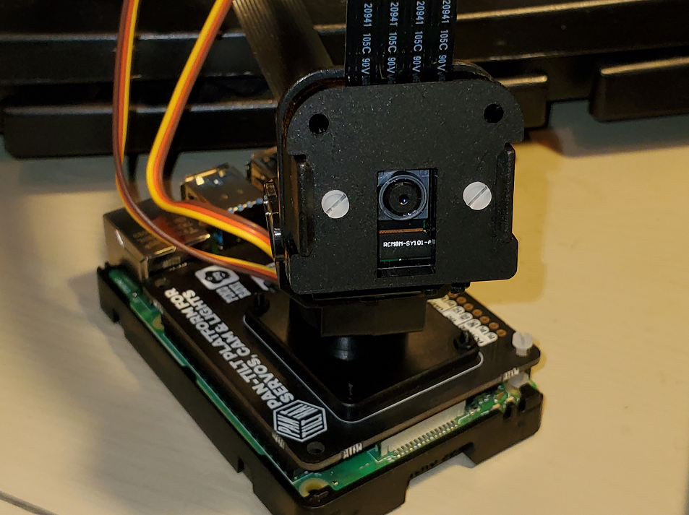
Overview
Hardware
Operating System
Environments
Machine Learning
Deep Learning
Performance
Pitfalls and Ideas for the Future
Notes:
This project had a lot of moving parts:
We had the Hardware:
Raspberry Pi: a small, relatively inexpensive computer
Pimoroni Pan-Tilt HAT: which sits on top of the Raspberry Pi, hence the term “hat“
The Pan-Tilt Hat is for tracking people or objects; it pans, and it tilts
Raspberry Pi Camera: self explanatory
Intel Compute Stick 2: an external USB processor for Neural Nets
The Operating System:
The Raspberry Pi generally runs on some flavor of Linux.
The Raspberry Foundation (a charity in the United Kingdom) has their own version of Linux
This is not impressive; apparently Hannah Montana and Justin Bieber have their own versions of Linux too.
I do not know why, but that is something I read on the internet, so it must be true!
Anyway, the Raspberry Pi OS is a branch from a popular Linux Ditro called Debian
Unfortunately it is only available in 32-bit at this time, so I could not take full advantage of the 4-core 64-bit processor.
Environments:
As we all know and love Anaconda, I had to install it on the Raspberry Pi.
Or at least I tried to.
Because of hardware restrictions, I had to install miniconda instead, which worked well!
I also found Venv to be useful for trying to install the Intel Compute Stick, but that didn’t pan out.
So in the end I used miniconda for this project.
Machine Learning:
I installed the OpenCV Library on the Raspberry Pi.
It is a computer vision Library written in C++, but also has bindings in Python, Java, and MatLab.
Using this Library I had access to some facial recognition algorithms, such as the Haar Cascade algorithm.
Deep Learning:
With some help I found the YOLO algorithm,
Which stand for You Only… LOOK Once.
Fortunately, OpenCV interfaces with YOLO, using the Darknet Distributed Neural Network
I will talk more about these algorithms and more in a moment.
But first I want to talk more about the Hardware.

Slide 4
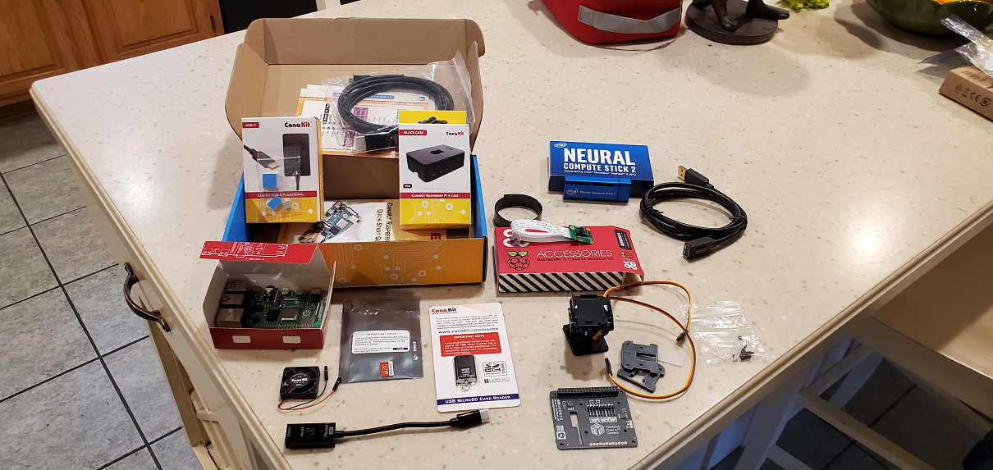
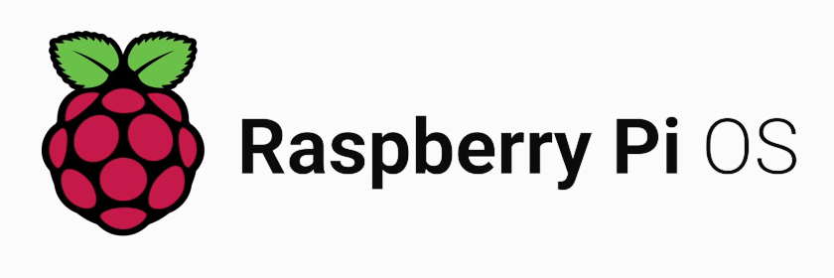
Making my Pi
Hardware
Operating System
Notes:
Hardware
I had to assemble the mess of stuff you see there on the left.
The Pan-Tilt HAT needed quite a bit of assembly
I ended up making a Blog post about it because the instructions were not great.
They were not bad either, they just lacked some detail.
The Raspberry Pi is actually somewhat simple to put together.
You put the OS on a microSD card and put the card in a slot in the front.
Then you plug in a mouse, keyboard, and monitor, and plug it into the wall and it is ready
The Operating System:
As I mentioned, the Raspberry Pi generally runs on some flavor of Linux.
And I mentioned that you need to put the OS on a microSD card
The process is actually quite easy, and just requires a card reader and an internet connection.
Raspberry Pi has a tool called “Imager” that you download and you tell it how you want to use the Raspberry pi.
I think you can even put your Wifi SSID and password in the app and it puts that information onto your installation
If anyone is looking for a fun project, I recommend grabbing one of these.
They make it very easy to use and they are generally not expensive.
And only every now and again will you question why you ever bought one and want to kick it across the room.

Slide 5
Object Detection Algorithms
2001
Haar Cascade
2013
HOG
YOLO (v1)
2015
Notes:
Haar Cascade
From a paper by Paul Viola and Michael Jones
"Rapid Object Detection using a Boosted Cascade of Simple Features".
Built off of the use of a Haar wavelet from a paper by Constantine P. Papageorgiou and others (1998, A General Framework for Object Detection)
HOG (Histogram of Oriented Gradients)
I did not use this and will not cover this much, but it is a popular Object Detection Algorithm and I wanted to show it in the timeline
From what I read, this is what SnapChat uses
This process basically calculates the gradient in 8x8 regions of a picture
By finding the direction the gradients are going in, you can capture the shape of objects.
YOLOv1
From University of Washington, Professor Joseph Redmon and some colleagues put out a paper in 2015,
"You Only Look Once: Unified, Real-Time Object Detection"
YOLO works by applying a single neural network to an image and breaking it into smaller regions
More notable iterations of the OLO algorithm are
YOLOv3 which was published in 2018 – also by Joseph Redmon and Ali Farhadi, and
YOLOv4 which was published in 2020 by Alexey Bochkovskiy and others
Both have a “tiny” version

Slide 6
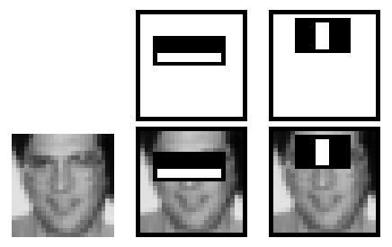
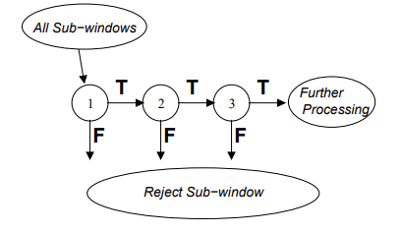
Haar Cascade
Haar Wavelet
Cascade with AdaBoost
Notes:
As I mentioned, the Haar Cascade uses a Haar Wavelet
The Haar Wavelet, which is a sequence of rescaled “square-shaped” functions, which Mr. Papa-Georgio used with support vector machines (or SVMs) to find important relationships between basis functions for object detection.
The Haar Wavelet is the Black and white rectangles in the pictures.
Viola and Jones took this idea and used the Haar Wavelet to find the sum of the pixels in the white square and subtract it from the sum in the black square.
This gave a better idea of features in a region instead of calculating a relationship between the pixels individually.
Since the eye region generally appears darker than surrounding areas such as the cheeks and the nose, this method is very good at detecting facial features.
The algorithm use Cascade Classifiers to process the regions of the picture and discards any region that is not a Region of Interest (ROI)
This part is enhanced by using the AdaBoost Algorithm to construct strong classifiers from a combination of weaker classifiers

Slide 7
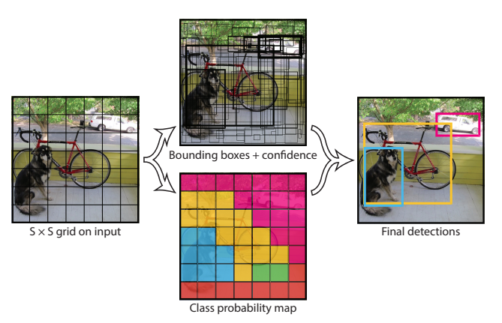
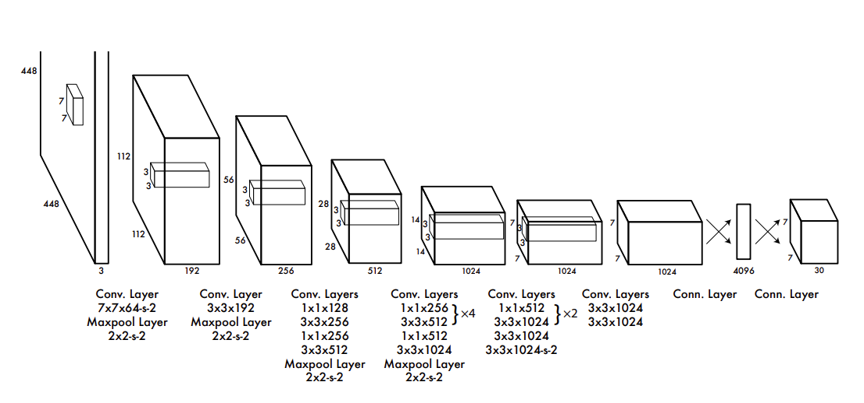
YOLO
One Neural Network
Predicts bounding boxes
Notes:
Since its first iteration in 2015, YOLO boasts the ability to
Process images in real-time at 45 frames a second, and the smaller version
Fast YOLO processes at 155 frames per second.
I unfortunately did not have that experience due to hardware constraints.
YOLO utilizes the open source Neural Network Framework, Darknet – also created by Joseph Redmon. It is written in C and CUDA
As I mentioned earlier, the YOLO algorithm uses one neural net (with Darknet), but as you can see, has many convolution layers
The neural network breaks the image apart into these smaller regions to predict bounding boxes and probabilities for each region.
The bounding boxes are weighted by the predicted probabilities.

Slide 8

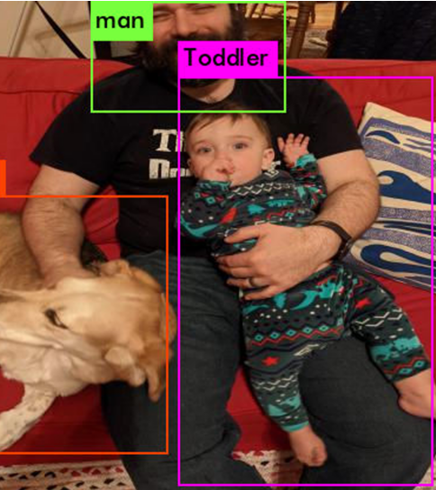
Using YOLOv4-tiny for full-body detection
Predicted in 11.278000 milli-seconds.
dog: 32%
man: 83%
Toddler: 69%
Notes:
With my First attempt,
Running in Google Colab I was able to test my first Neural Network
You can see here that since my son’s face is slightly obscured, so he received a lower confidence rating from YOLO
I also noticed, since I am holding my son in some of these photos (at least the photos that I am in)
That my beard is right behind my son’s head.
Oddly, Because of this, I think that the model thinks that my beard could be a toddler

Slide 9
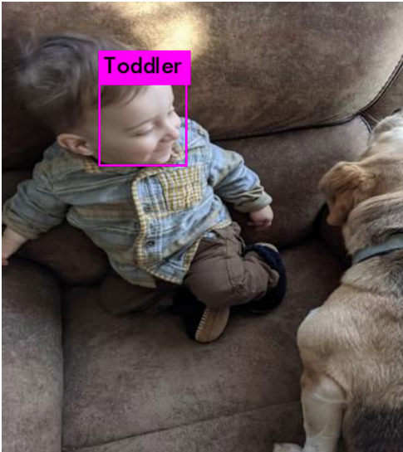
Using YOLOv4-tiny for Face Detection
Predicted in 5.150000 milli-seconds.
Toddler: 97%
Notes:
Since the previous Model would sometimes think my beard was a toddler,
I made a second attempt to see if there was a difference if I focused on just my son’s face.
This model is very effective, but requires much of his face to be at JUST the right angle.
So, even though this seems to be a more effective model, I think I like the other model better.

Slide 10
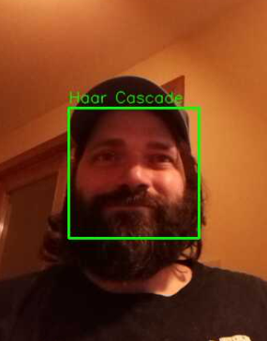
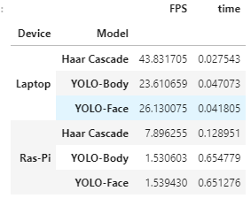
Haar Cascade
Notes:
My favorite model – For theRaspberry Pi, anyway
ended up being the Haar Cascade.
I was able to calculate the time it took to process and render an image,
With this table I calculated the time for each of these three models, on both the Raspberry Pi,
as well as my Laptop which has 3 times the RAM and a much better processor
If you look at the frames per second, the Haar Cascade easily outperforms the YOLO Algorithm
But on my Laptop I did not really notice much difference since the YOLO Algorithm had an
FPS similar to what you see with old movies or a Standard Definition TV (about 24 to 29 FPS)
On the Raspberry Pi, however, the Latency is very noticeable and distracting.

Slide 11
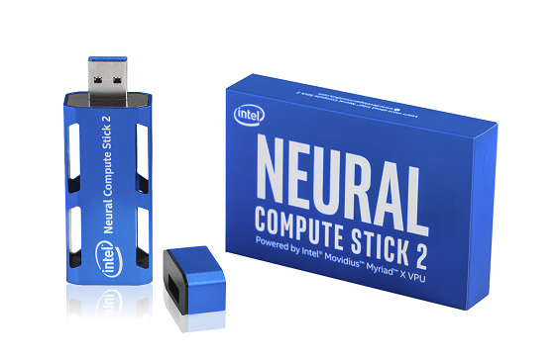
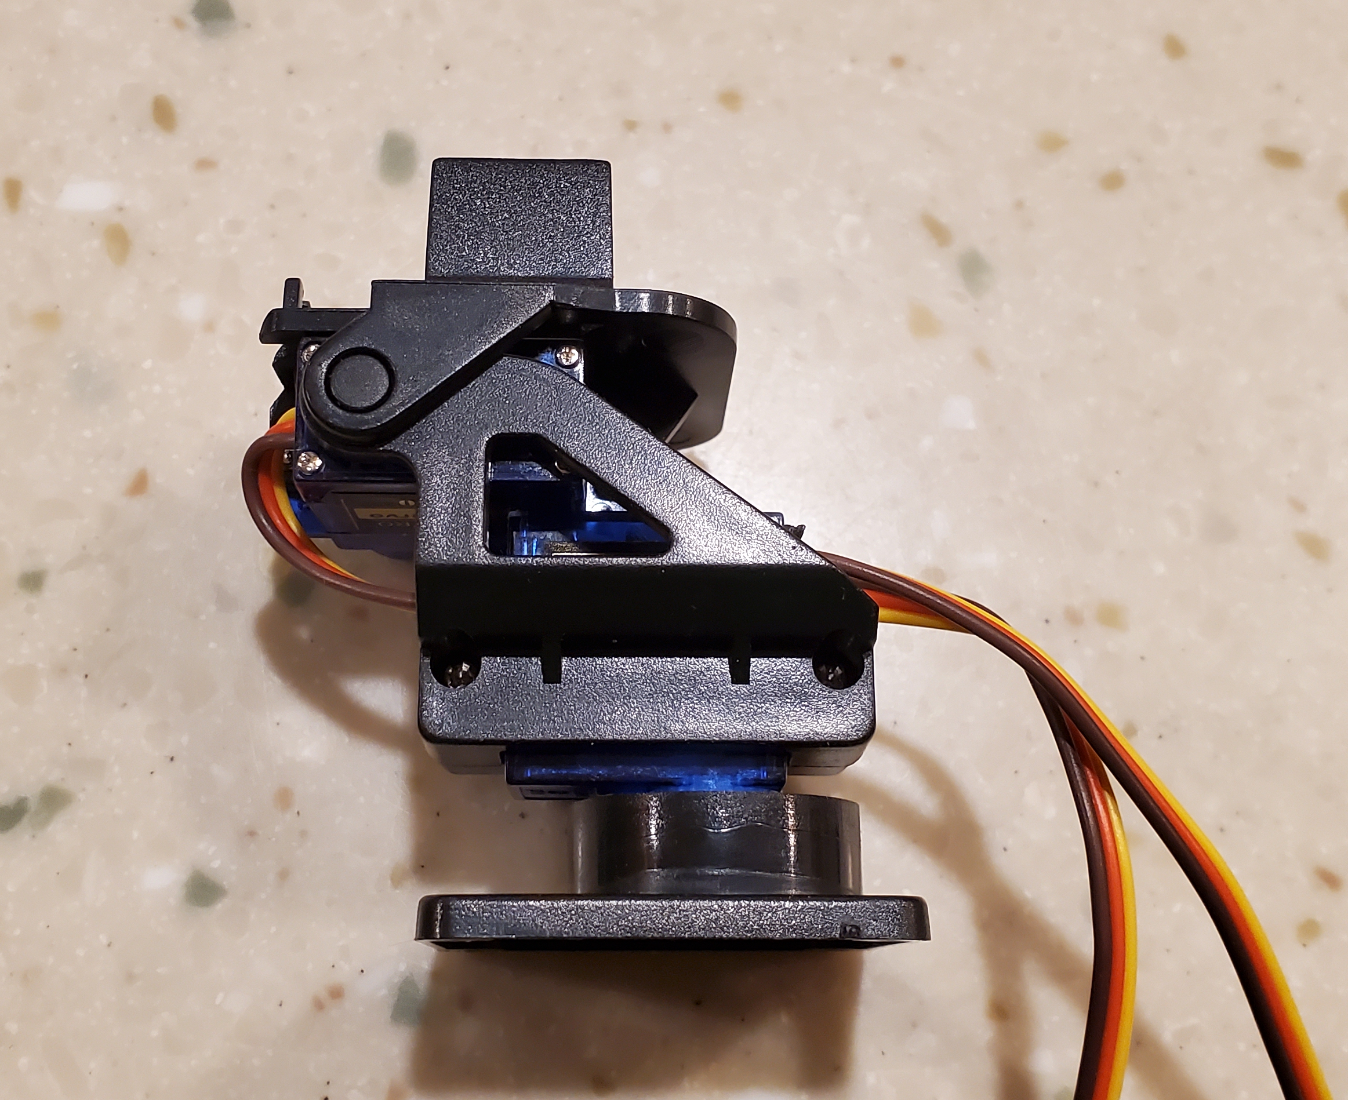
Pitfalls
Notes:
Some of the Pitfalls I encountered generally revolved around the Raspberry Pi
And getting Hardware to function properly with the software made for it
One was with getting the Intel compute stick to work.
It uses a software library OpenVino, and then Intel has its own repository for the stick
There is supposed to be support for Raspberry Pi, but I was not able to get the packages to install.
Specifically, the installer hangs on installing Tensorflow.
Which is strange because I ended up installing Tensorflow in that environment, and there is still issues.
So… I Did not get the working yet.
Another was some issue I had with the Pan-Tilt HAT.
I actually had to rewrite the python file that was supposed to move the Pan-Tilt Hat
The software inexplicably moved the Camera to the bottom left corner.
Maybe it was tracking some ghosts – I don’t know.
But I rewrote that code, and that ended up working out ok
I also had some issues with my venv and miniconda environments on my raspberry pi
But I was able to use these environments with some weirdness,
So that is just something to work on for another day!

Slide 12
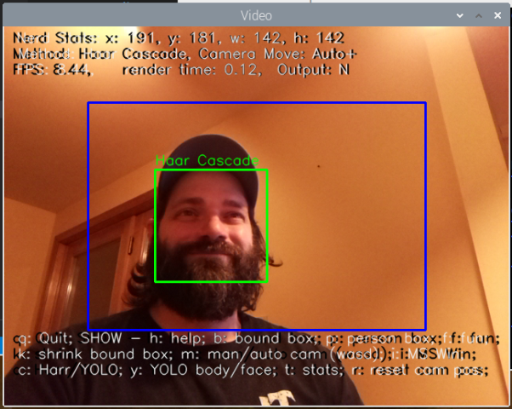
Add ons!
Stats and Settings!
Keyboard Shortcuts!!
Notes:
To make this more interactive I actually added some keyboard shortcuts.
For instance, you can add and remove the boxes
and toggle the help menu and/or the stats at the top that tell you
what model you are looking at,
The FPS and render time,
As well as the position of the object detection box!
I also added functionality to switch between the three different Models
And you can disable the camera from moving, as well as reset its position
And you can control the camera’s movement with the familiar WASD keys (for all you gamers out there)
And there is a fun surprise when you hit the f key (for “fun”)
>>> RUN DEMO HERE <<<

Slide 13
Ideas for the Future
64-bit OS (e.g. Ubuntu)
Intel Compute Stick
Google Coral USB Accelerator
Other Hardware with moving camera
Stream video to Flask
Notes:
So, some Ideas for the future include (but are not limited to)
Installing a 64-bit OS on the Raspberry Pi, like Ubuntu
This is difficult since the Pi already has it’s own OS.
Regardless, I have already begun trying to do this.
Unfortunately the Ubuntu Server OS that is compatible with the Raspberry Pi runs a “headless” configuration
And I am having trouble installing the Gnome desktop.
Which brings me to my next bullet point – the Intel Compute stick.
I am hoping if I can get a 64 bit OS, I can upgrade things, like Python and Tensorflow
Or, I can see about implementing the Google Coral USB Accelerator.
This was actually my first choice, but these things are so high in demand
that they are all sold out or have wait times of several months (which was probably not enough time for this project)
Reading about how easy these are to use, I kind of wish I ordered one instead of the Intel Compute Stick 2
(As far as getting this to work, I would probably be at the same point or better!)
Another option would be to use completely different hardware.
For instance, I know my laptop can run the YOLO Model with no issue.
So it might be possible to find a moving-camera to connect over USB-C
And finally, I think it would be cool to get this running with Flask.
In fact, I was able to get the camera to stream over my local network
Which is perfect! I do not want this stream leaving my house.
Unfortunately I did not have time to incorporate camera movement
or Machine Learning Models yet.
To go back to my idea at the beginning,
I tested it out, and I was able to use Google Duo
On a call with my mom and dad, and enable the share screen feature.
I then accessed the webpage served by Flask on my local network
So my mom and dad could see what the camera was streaming.
>>> GO TO FLASK HERE <<<
But with time, I think that is something that can be somewhat easily done!

Slide 14
Conclusion
Is it possible to track a person and their movement with a moving camera?
Yes!
…and we can do more.
Notes:
So, Is it possible to track a person and their movement with a moving camera?
Yes.
But we can also do more!

Slide 15
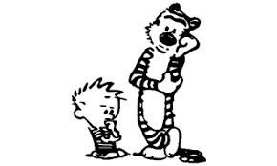
Questions?
Notes:
Thank you for listening about my Object-Tracking project.
Re there any Questions?

Slide 16
Sources
Installing opencv on raspberry pi:
https://www.pyimagesearch.com/2019/09/16/install-opencv-4-on-raspberry-pi-4-and-raspbian-buster/
OpenCV
https://opencv-tutorial.readthedocs.io/en/latest/yolo/yolo.html https://docs.opencv.org/3.4/db/d30/classcv_1_1dnn_1_1Net.html
Camera Pan-Tilt-Hat
https://pantilt-hat.readthedocs.io/en/latest/ https://learn.pimoroni.com/tutorial/sandyj/assembling-pan-tilt-hat https://learn.pimoroni.com/tutorial/electromechanical/building-a-pan-tilt-face-tracker https://github.com/pimoroni/pantilt-hat https://github.com/pimoroni/PanTiltFacetracker/blob/master/facetracker_lbp.py
Intel Neural Compute Stick 2:
https://docs.openvinotoolkit.org/latest/openvino_docs_install_guides_installing_openvino_raspbian.html https://www.hackster.io/news/getting-started-with-the-intel-neural-compute-stick-2-and-the-raspberry-pi-6904ccfe963 https://www.youtube.com/watch?v=LmtHEBuJfII https://www.youtube.com/watch?v=joElT3UfspA

Slide 17
Sources
Haar Casacade
https://docs.opencv.org/3.4/db/d28/tutorial_cascade_classifier.html https://ieeexplore.ieee.org/document/710772 https://www.cs.cmu.edu/~efros/courses/LBMV07/Papers/viola-cvpr-01.pdf https://en.wikipedia.org/wiki/Viola%E2%80%93Jones_object_detection_framework https://en.wikipedia.org/wiki/Cascading_classifiers https://en.wikipedia.org/wiki/AdaBoost
YOLO
https://pjreddie.com/media/files/papers/yolo_1.pdf https://pjreddie.com/media/files/papers/YOLOv3.pdf https://stackoverflow.com/questions/57706412/what-is-the-working-and-output-of-getlayernames-and-getunconnecteddoutlayers https://arxiv.org/abs/2004.10934 https://arxiv.org/abs/2011.08036 https://datascience.stackexchange.com/questions/65945/what-is-darknet-and-why-is-it-needed-for-yolo-object-detection
Roboflow.com (and CVAT)
https://towardsdatascience.com/how-to-train-a-custom-object-detection-model-with-yolo-v5-917e9ce13208 https://blog.roboflow.com/cvat/ https://blog.roboflow.com/train-yolov4-tiny-on-custom-data-lighting-fast-detection/ https://www.youtube.com/watch?v=NTnZgLsk_DA&t=212s

